Slide 1
Representation Learning for Attributed Multiplex Heterogeneous Network
GNN Study Group

Slide 2
Agenda
Abstract
Problem Define
Model
Experiment
Conclusion

Slide 3
Abstract

Slide 4
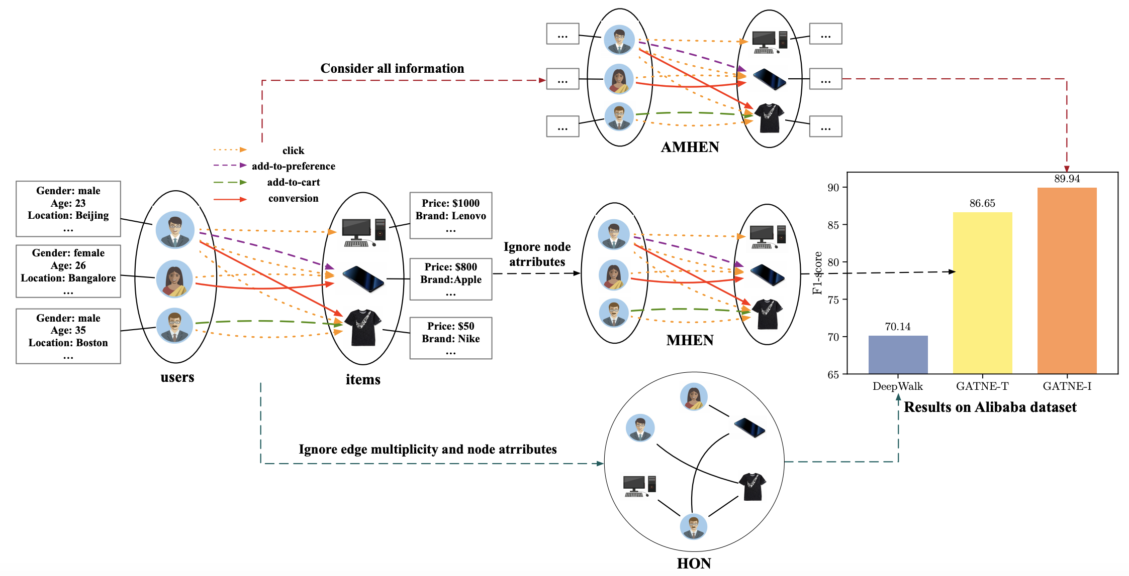
Different type of GNN network

Slide 5
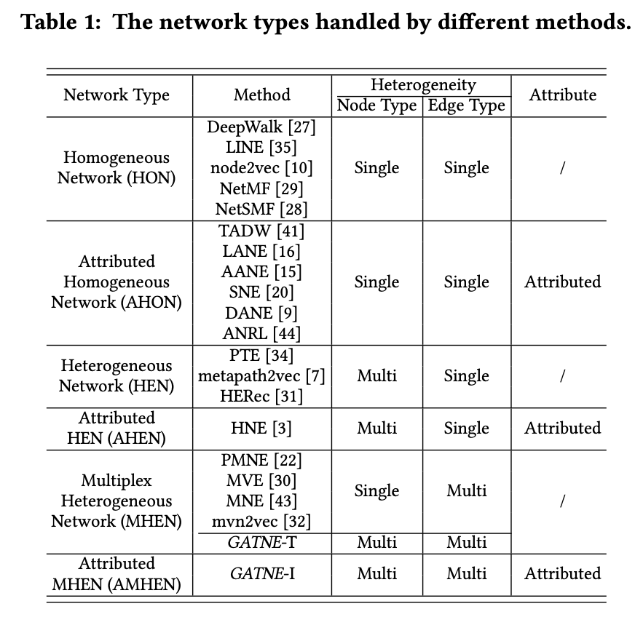
Different type of GNN network
Depending on the Network Topology (homogeneous/heterogeneous) and Attributed Property (with/without attributes), we categorize six different types of networks
This paper focus on embedding learning for AMHENs, and offer two methods: GATNE-T (Transductive) and GATNE-I (Inductive)
Notes:
https://github.com/THUDM/GATNE

Slide 6
Challenges for AMHEN
Multiplex Edges
Each node pair may have multiple different types of relationships. It is important to learn unified embeddings.
Partial Observations
Most existing network embedding methods focus on the transductive settings, and cannot handle the long-tailed or cold-start problems.
Scalibility
It is important to develop learning algorithms that can scale well to large networks.

Slide 7
Problem Define

Slide 8
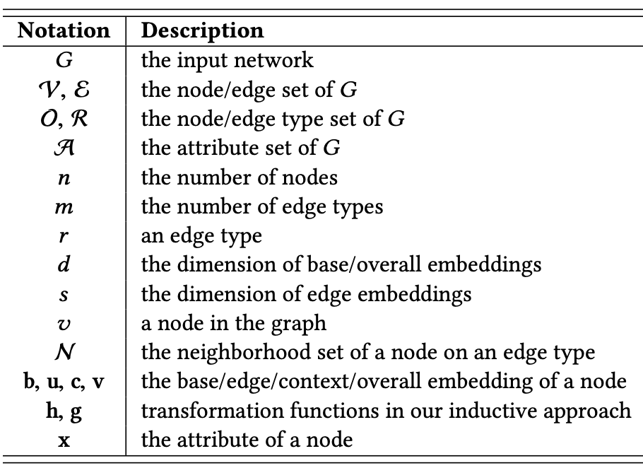
Problem Define
Given an AMHEN G = (V, E, A), the problem is to give a unified low-dimensional space representation of each node v on every edge type r.
Function Fr : V → Rd for every edge type r, where d ≪ |V |.
For each edge type, we are learning different space representation. But each representation is not independent, we are learning a model to deal with this interaction
Notes:
由於有多種類型的邊(比如點擊、購買)，這裡我們考慮給每個節點在每種邊類型下都學一個表示。比如我們給用戶和商品在點擊場景下學一種表示，在購買場景下學一種表示。但是這兩種表示之間並不是完全獨立的，是通過某種機制互相影響的。我們主要考慮的就是如何來建模不同類型的表示之間相互影響的方式。

Slide 9
Model

Slide 10
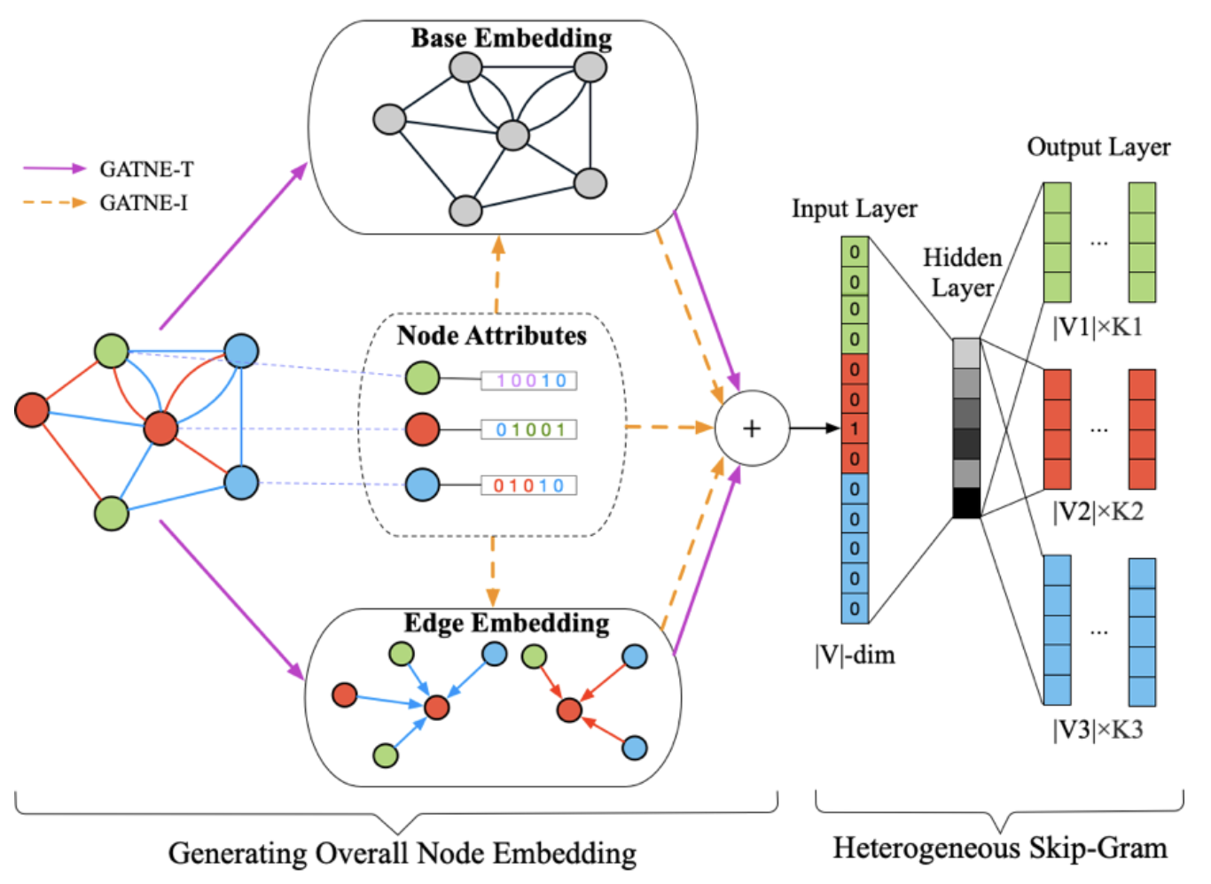
Model - Transductive
Model split the overall embedding into two part :
1). Base Embedding : The base embedding of node vi is shared between different edge types.

Slide 11


Model - Transductive
Model split the overall embedding into two part :
2). Edge Embedding : The k-th level edge embedding of node Vi on edge type r is aggregated from neighbors’ edge embeddings as:

Slide 12



Model - Transductive
We denote the K-th level edge embedding as edge embedding ui,r , and concatenate all the edge embeddings for node Vi as Ui :
where m is number of edge type
We use self-attention mechanism to compute the coefficients ai,r ∈ Rm of linear combination of vectors in Ui on edge type r as:
where wr and Wr are trainable parameters for edge type r
The overall embedding of node vi for edge type r is:
where bi is the base embedding for node Vi
αr is a hyper-parameter denoting the importance of edge embeddings
Mr ∈ Rs×d is a trainable transformation matrix

Slide 13


Model - Inductive
The limitation of transductive model is that it cannot handle unobserved data.
In GATNE-T, the initial edge embedding ui,r and base embedding bi is randomly initialized.
In GATNE-I, it is determined by node attributes :
where hz is a transformation function
z = ϕ(i) is node Vi’s node type
where gz,r is a transformation function

Slide 14

Model - Inductive
The overall embedding of node vi for edge type r is:
where βr is a coefficient
Dz is a feature transformation matrix on vi ’s corresponding node type z

Slide 15
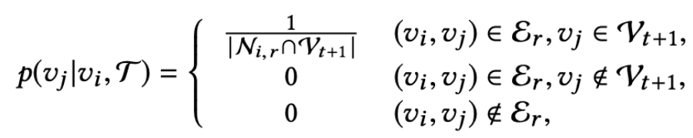
Model Optimization
We use meta-path-based random walk to generate node sequences and then perform heterogeneous skip-gram over the node sequences to learn embeddings. To be specific, we set up meta-path scheme in advance (i.g.: User-Item-User). The transition probability at step t is defined as follows:
where vi ∈ Vt and Ni,r denotes the neighborhood of node vi on edge type r

Slide 16
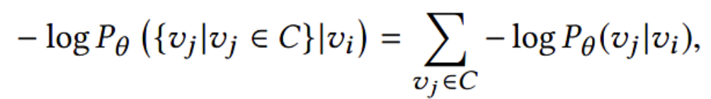
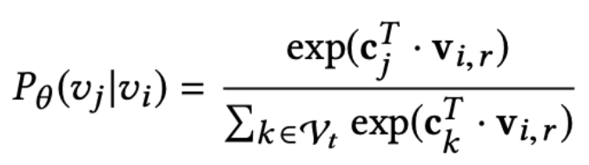
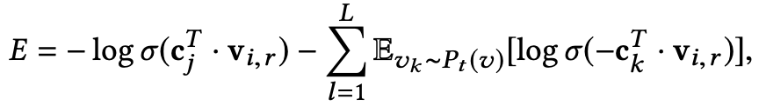
Model Optimization
Thus, given a node vi with its context C of a path, our objective is to minimize the following negative log-likelihood:
Following metapath2vec, we use the heterogeneous softmax function. Specifically, the probability of vj given vi is defined as:
Finally, we use heterogeneous negative sampling to approximate the objective function − log Pθ (vj |vi) for each node pair (vi ,vj) as:
Notes:
在skip-gram過程中採用「negative sampling」，使每個訓練樣本只會更新一小部分的模型權重，從而降低計算負擔。
不同于原本每个训练样本更新所有的权重，负采样每次让一个训练样本仅仅更新一小部分的权重，这样就会降低梯度下降过程中的计算量。
https://zhuanlan.zhihu.com/p/39684349

Slide 17
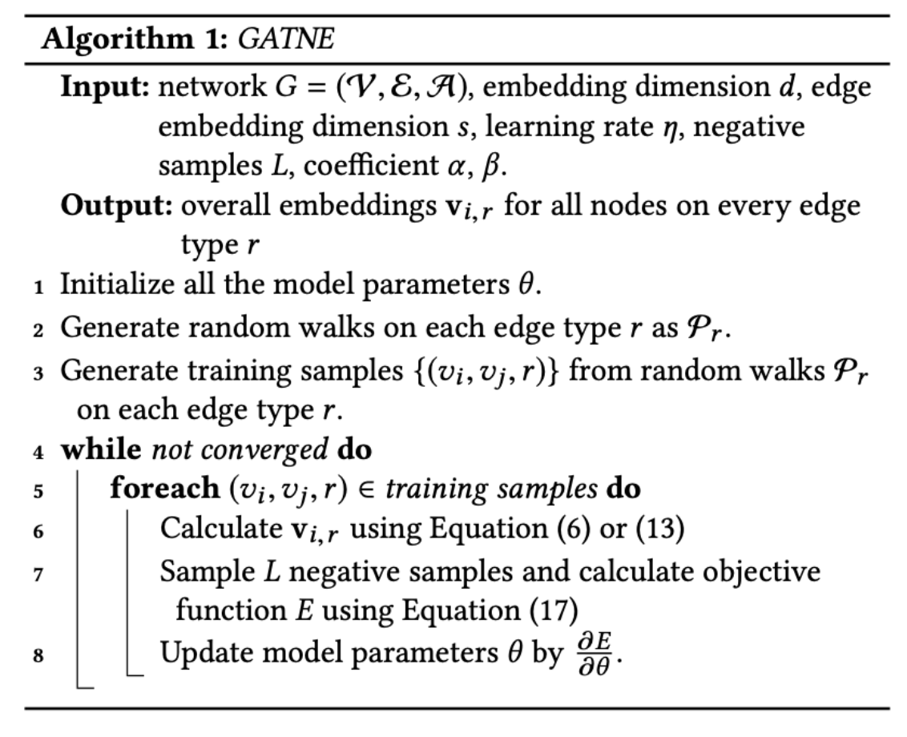
Model Optimization
Equation 6:
Equation 13:
Equation 17:

Slide 18
Experiment

Slide 19
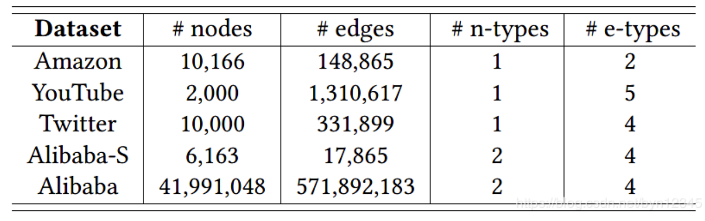
Evaluation Dataset

Slide 20
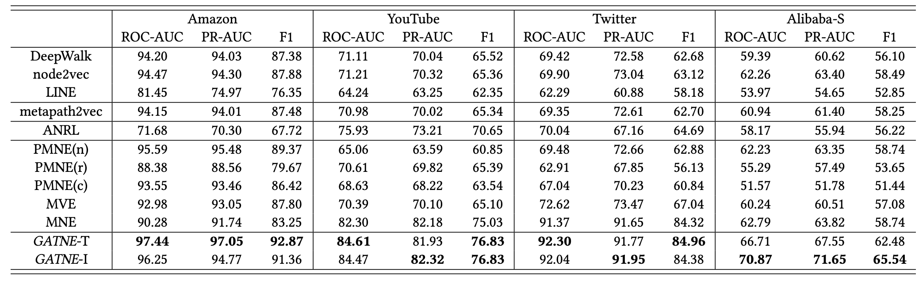
Result
Notes:
如下表所示，在3个公开数据集和阿里小数据集上，我们提出的GATNE-T/I取得了最好的效果。Amazon数据集上由于商品的特征比较弱，所以GATNE-I的效果会稍差于GATNE-T；而在阿里数据集上，因为节点的特征非常丰富，所以GATNE-I的效果会好于GATNE-T。YouTube和Twitter数据集不包含节点特征，所以我们把DeepWalk跑出来的200维向量作为初始的节点特征。由于DeepWalk生成的特征也只利用了图的结构，没有引入额外的信息，所以两种方法GATNE-T/I的结果差别不大

Slide 21
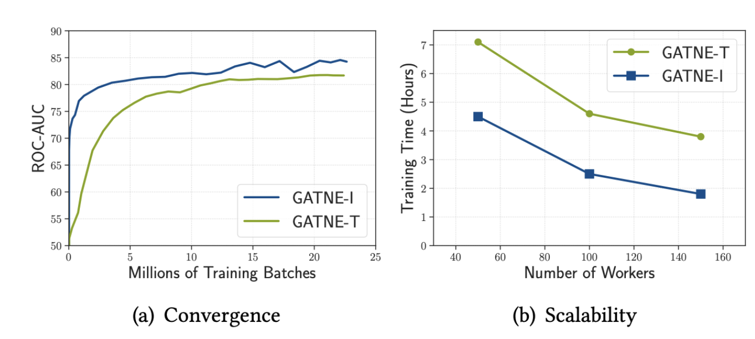
Result
Notes:
我们对模型的convergence和scalability进行了测试。在阿里大数据集上，相比GATNE-T来说，GATNE-I能够更快地达到比较好的效果。并且，随着模型所使用的worker数量的增加，GATNE-T/I模型的训练时间都能显著降低。

Slide 22
Conclusion

Slide 23
Conclusion
We split the overall node embedding of GATNE-I into three parts: base embedding, edge embedding, and attribute embedding.
The base embedding and attribute embedding are shared among edges of different types
The edge embedding is computed by aggregation of neighborhood information with the self-attention mechanism
Notes:
我们对模型的convergence和scalability进行了测试。在阿里大数据集上，相比GATNE-T来说，GATNE-I能够更快地达到比较好的效果。并且，随着模型所使用的worker数量的增加，GATNE-T/I模型的训练时间都能显著降低。

Slide 24
Thanks

